Slide 1
Developing a Leadership Mindset
Samuel C. Jones (SES)
Division Chief for Economic Applications Division
Economic Directorate
U.S. Census Bureau
May 25, 2017

Slide 2
Are You Creating Followership?

Slide 3
What is Followership?
Followership is a straightforward concept. It is the ability to take direction well, to get in line behind a program, to be part of a team and to deliver on what is expected of you. It gets a bit of a bad rap! How well the followers follow is probably just as important to enterprise success as how well the leaders lead.

Slide 4
Understanding Power Motive
Power Motive¹
Personalized power motive is essentially self-serving, verily colored by unresolved achievement needs, and primarily instrumental to personal advancement and enhancement.
Socialized power motive is valued as an instrument for the common good, on behalf of the whole, a defining characteristic of successful managers.
___
¹ David C. McCelland, Power: The Inner Experience

Slide 5
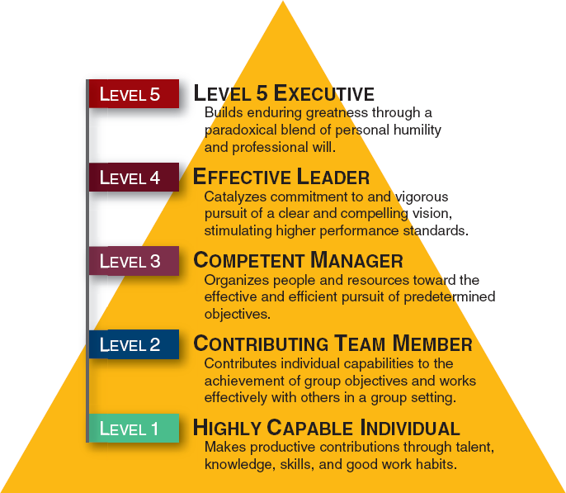
Level 5 Leadership
___
Jim Collins, Good to Great

Slide 6
Building Trust
Quotes for Reflection
"A man does what he must - in spite of personal consequences, in spite of obstacles and dangers and pressures - and that is the basis of all human morality." - John F. Kennedy
"A man without ethics is a wild beast loosed upon this world." - Albert Camus
"Winning is nice if you don't lose your integrity in the process." - Arnold Horshack
"The most important persuasion tool you have in your entire arsenal is integrity." - Zig Ziglar

Slide 7
Exhibiting Courage
Moral Courage
Definition. The willing endurance of significant danger for the sake of principle. Moral courage is the courage to be honest, fair, respectful, responsible, and compassionate.
Three Elements of moral courage
Principles
Danger
Endurance

Slide 8
Building an Ethical Culture
Slide Title
Organizational Culture
According to scholars, differences in the organizational culture can largely explain why some organizations are much more successful than others.

Slide 9
It’s a Matter of Choice!!!
Slide Title

Slide 10
Peak Performers by Charles Garfield (1987)
Grit by Angela Duckworth (2016)

Slide 11
DAILY CHALLENGES FACED BY CHAMPION LEADER

Slide 12
candidate selection championing change change leadership change management coaching employees coaching others coaching services confronting poor performance discipline emotional intelligence employee motivation Executive Leadership Coaching hiring hiring tip influence inspiration interviewing Leadership Skills leading change mentoring organizational change Performance Management picking the best candidate picking the right person Team Building

Slide 13
You Must Decide and Then Act

Slide 14
SEVEN TOP QUALITIES FOR A CHAMPION LEADER
BECOMING A SELF-LEADER
Have you ever met someone and before you have spoken to them, you just know there is something about them that seems impressive and stands out from the crowd? This is called ‘presence’.
Self-leadership is all about you knowing yourself well enough with a strong personal and professional foundation, so much so, that others are affected just by who you are ‘being’. By becoming conscious with every action you take, every word you speak is naturally inspiring, persuasive and innovative.

Slide 15
Self-Direction – a “game plan” for your life
Self- Management – make it happen
Self-Awareness – know yourself well and tune into others around you
Self-Discipline – Do what you say you are going to do
Self-Image – Act like a “winner” by facing challenges and opportunities
Self-Confidence – Positive self talk is key to positive self-confidence
Self-Expectancy – You always attract what you expect
annette@annettestanton.com/the-top-7-qualities-of-a-champion-leader/

Slide 16
You Can Make a Difference

